Slide 1

Slide 1
SMART FARM CROP HEALTH MONITOR
HIRWA Roy (ID: 24174)
PL/SQL Project
Adventist University of Central Africa
December 2025
Lecturer: Eric Maniraguha

Slide 2
THE CHALLENGE
• Traditional farming relies on manual inspection
• Delayed detection of crop issues
• No real-time monitoring system
• Data-driven decisions are difficult
• Crop losses affect food security
IMPACT: 20-40% crop loss due to late problem detection
Lecturer: Eric Maniraguha

Slide 3
OUR SOLUTION: Smart Monitoring System
• Real-time sensor data collection
• Automated health scoring
• Instant alert system
• Predictive analytics
• Mobile-friendly reports
KEY FEATURES:
✓ Soil moisture monitoring
✓ Temperature tracking
✓ Automated alerts
✓ Health scoring system
✓ Historical trend analysis

Slide 4
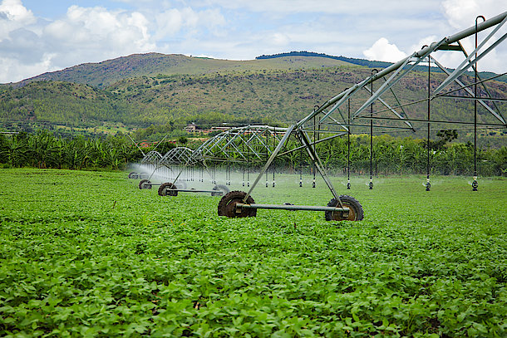
Target Users & Benefits
FARMERS:
• Early problem detection
• Better yield predictions
• Reduced manual work
GOVERNMENT:
• Agricultural data
• Food security planning
• Policy development
AGRICULTURAL EXPERTS:
• Remote monitoring
• Data for research
• Better recommendations
EXPECTED OUTCOMES:
• 30% reduction in crop loss
• 15% increase in yields
• Data-driven farming decisions

Slide 5
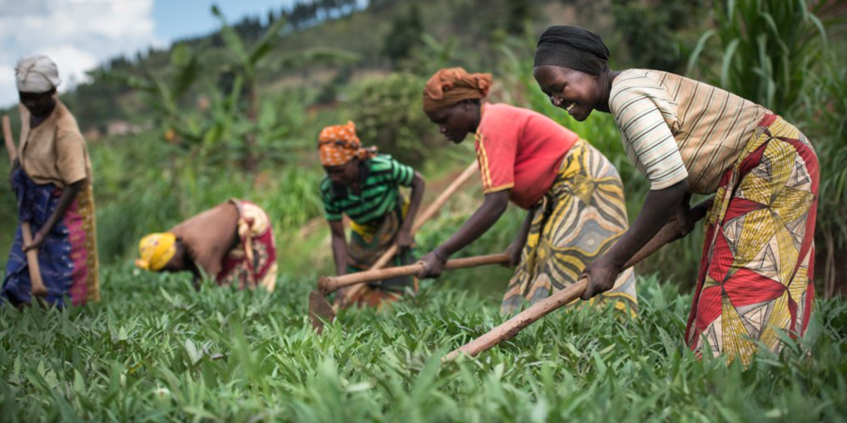
BUSINESS INTELLIGENCE INTEGRATION
PREDICTIVE ANALYTICS:
• Disease outbreak prediction
• Optimal harvest timing
• Yield forecasting
DASHBOARDS:
• Real-time farm health overview
• Alert management console
• Historical trend analysis
DATA-DRIVEN DECISIONS:
• Water usage optimization
• Fertilizer scheduling
• Crop rotation planning
FUTURE EXPANSION:
• Mobile app integration
• Weather data integration
• Market price correlation

